Slide 1
Introduction to K Nearest Neighbors

Slide 2
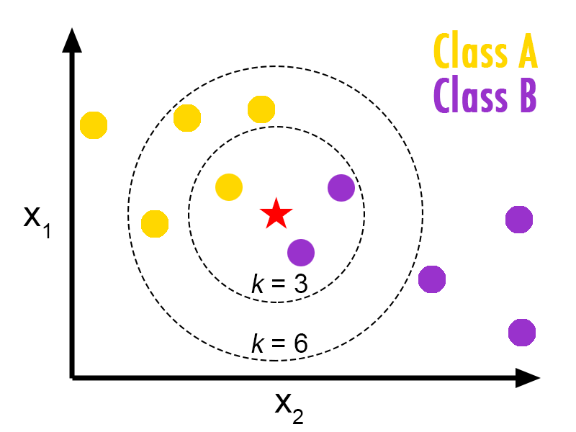
K-Nearest Neighbors
The KNN algorithm is a supervised machine learning algorithm that can be used to solve both classification and regression problems.
The KNN algorithm assumes that similar things exist in close proximity.

Slide 3
Main Properties of KNN
KNN is a lazy learning algorithm because it does not have a specialized training phase and uses all the data for training while classification.
KNN is also a non-parametric learning algorithm because it doesn’t assume anything about the underlying data.

Slide 4
Pseudocode: KNN Algorithm
Step 1: Initialize K to your chosen number of neighbors
Step 2: For each record in the data Calculate the distance between the test data
Step 3: Add the distance and the index of the example to an ordered collection.
Step 4: Sort the ordered collection in ascending order by the distances.
Step 5: Pick the Top K entries from the sorted collection

Slide 5
Pseudocode Continued…
Step 6: Get the labels of the selected K entries.
Step 7: If regression, return the mean of the K labels
Step 8: If classification, return the mode of the K labels
Note: We must be very careful while
selecting the K value for our data.

Slide 6
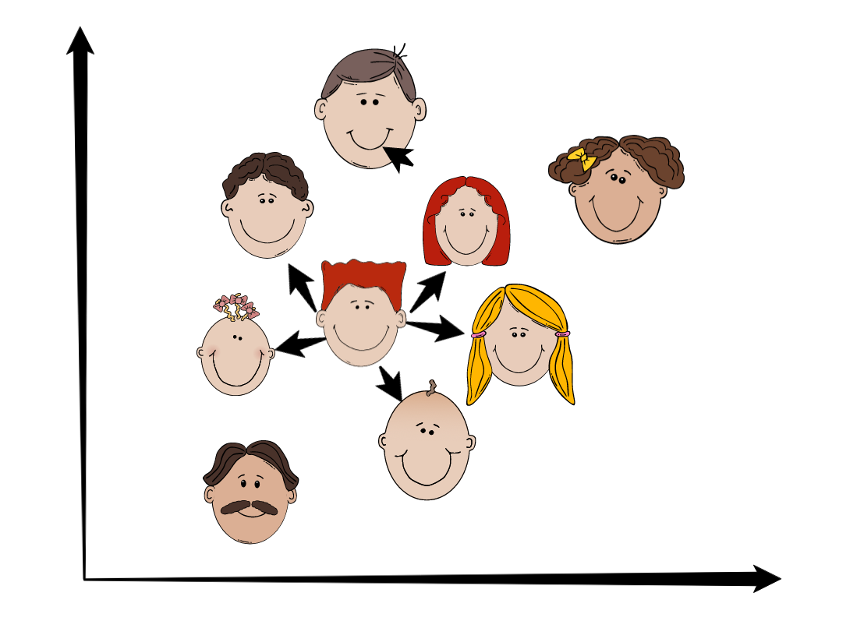
Advantages of KNN
It is a very simple algorithm to understand and interpret.
It is very useful for nonlinear data because there is no assumption about data in this algorithm.
It is a versatile algorithm as we can use it for classification as well as regression.

Slide 7
Disadvantages of KNN
It is computationally a bit expensive because it stores all the training data.
High memory storage required as compared to other supervised learning algorithms.
It is very sensitive to the scale of data as well as irrelevant features.

